Slide 1

IMPLEMENTING A SECURE FIRMWARE UPDATE MECHANISM FOR IOT DEVICES
Secure Boot, Code Signing, Firmware Verification & Secure Updates

Slide 2
PROJECT OVERVIEW
PURPOSE
Develop a secure mechanism for delivering firmware updates to IoT devices.
Ensure only authentic and untampered firmware is accepted.
Protect firmware delivery, authorization, and update management.
SECURITY CONTROLS IMPLEMENTED
•
SHA-256 integrity verification
ECC P-256 digital signatures
Signed U-Boot FIT firmware artifact
HTTPS/TLS secure transport
Device authentication
Role-Based Access Control (RBAC)
Audit logging
Rollback protection
Backup and recovery
Update scheduling and notifications
LABORATORY IMPLEMENTATION
Controlled cybersecurity laboratory demonstration using Ubuntu Server, Nginx, OpenSSL, Python, SQLite and U-Boot FIT.

Slide 3
PROBLEM STATEMENT
Content:
IoT devices frequently require firmware updates to fix vulnerabilities, improve functionality, and maintain security.
However, an insecure firmware-update process can allow:
Malicious firmware to be installed on the device
Firmware tampering during transmission
Unauthorized firmware signed with an unknown key
Corrupted firmware to cause device failures
Downgrade attacks to vulnerable older versions
Unauthorized users to deploy firmware updates
Insufficient auditability of update activities
Project Goal:
Design and demonstrate a trusted firmware-update lifecycle that verifies firmware authenticity and integrity before installation and provides secure update management.

Slide 4
PROJECT OBJECTIVES
Secure Boot Integration
Implement and evaluate verified firmware boot using U-Boot FIT.
Code Signing & Cryptography
Use ECC P-256 digital signatures and SHA-256 integrity verification.
Firmware Verification
Reject tampered, corrupted, and unauthorized firmware before installation.
Secure Update Server
Deliver firmware through an authenticated HTTPS/TLS server.
Access Control
Implement Role-Based Access Control (RBAC) for update management.
Audit & Monitoring
Record update-management actions and generate notifications.
Failure Recovery
Maintain firmware backup and verify the installed firmware after updates.
Compliance & Usability
Document security guidance, limitations, scheduling, and update-management procedures. Small status line at bottom
Goal: Establish a trusted firmware lifecycle from signing s delivery s verification s installation s monitoring.

Slide 5
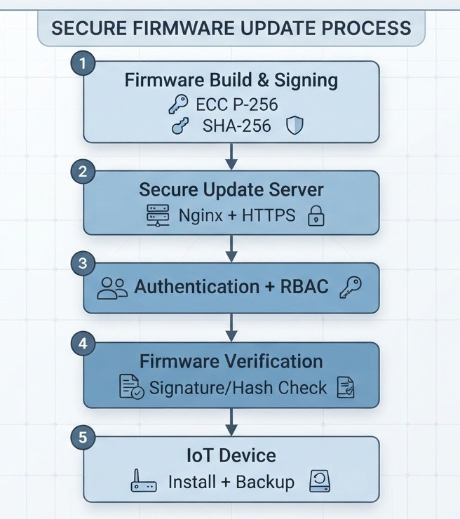
SYSTEM ARCHITECTURE

Slide 6
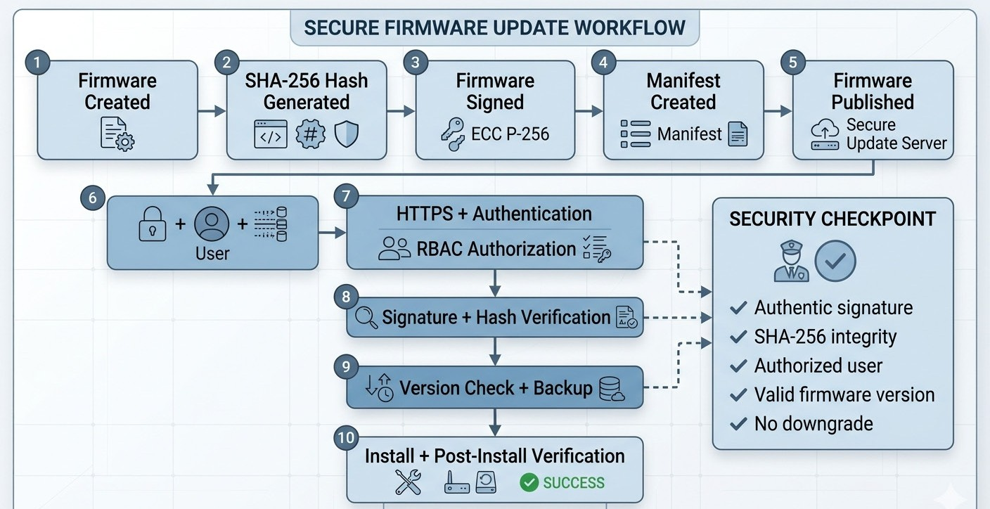
SECURE FIRMWARE UPDATE WORKFLOW

Slide 7
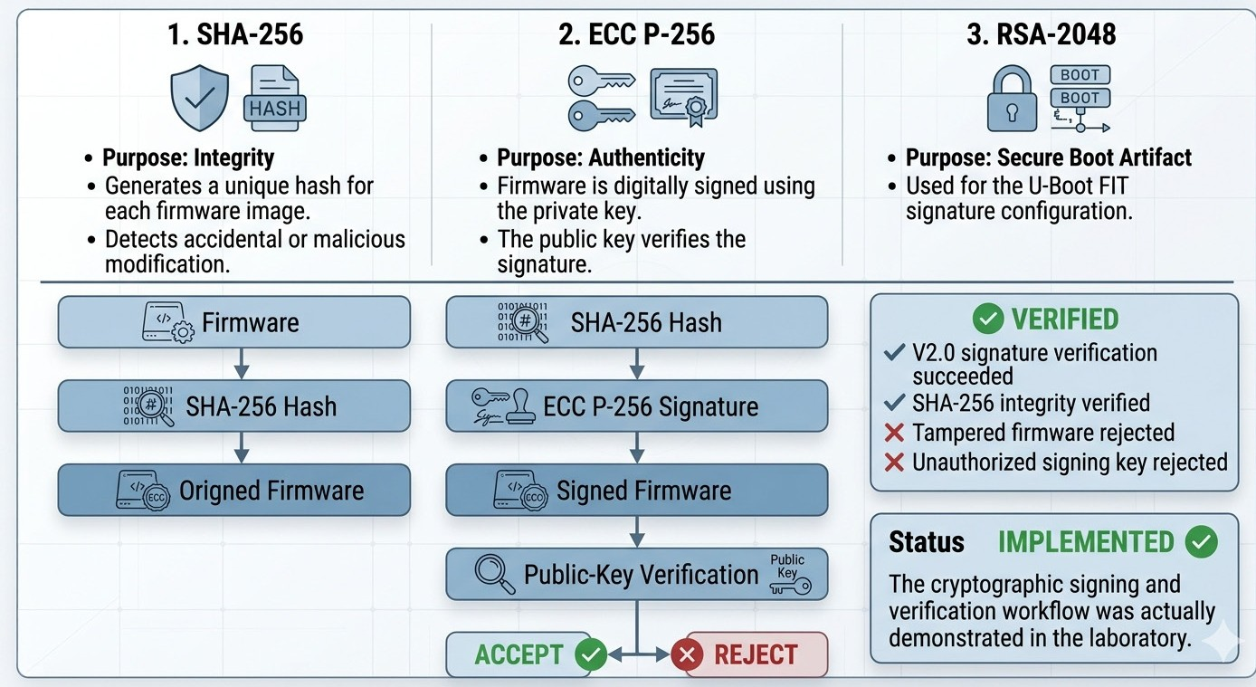
CRYPTOGRAPHIC SECURITY

Slide 8
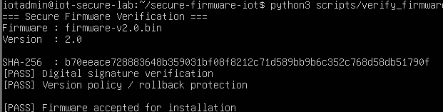
FIRMWARE SIGNING & VERIFICATION
PROCESS
Firmware V2.0
↓
SHA-256 Hash
↓
ECC P-256 Private Key
↓
Digital Signature
↓
Signed Firmware
↓
Public Key Verification
firmware-v2.0.bin using OpenSSL.
STATUS: IMPLEMENTED
ECC P-256 digital signature + SHA-256 integrity verification

Slide 9
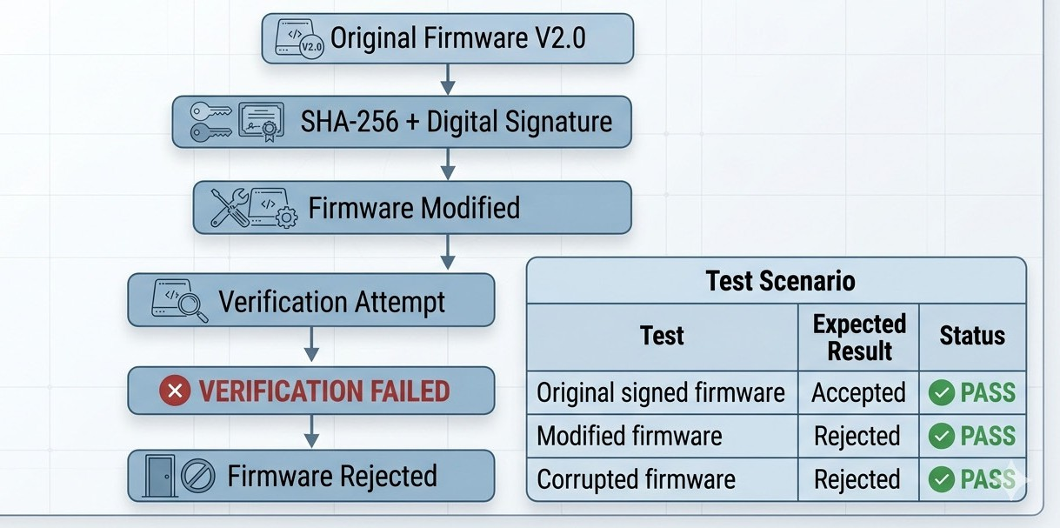
TAMPER DETECTION
Evidence: Modified/corrupted firmware was tested and prevented from being accepted.

Slide 10

Evidence
Firmware modification is detected through cryptographic verification.

Slide 11
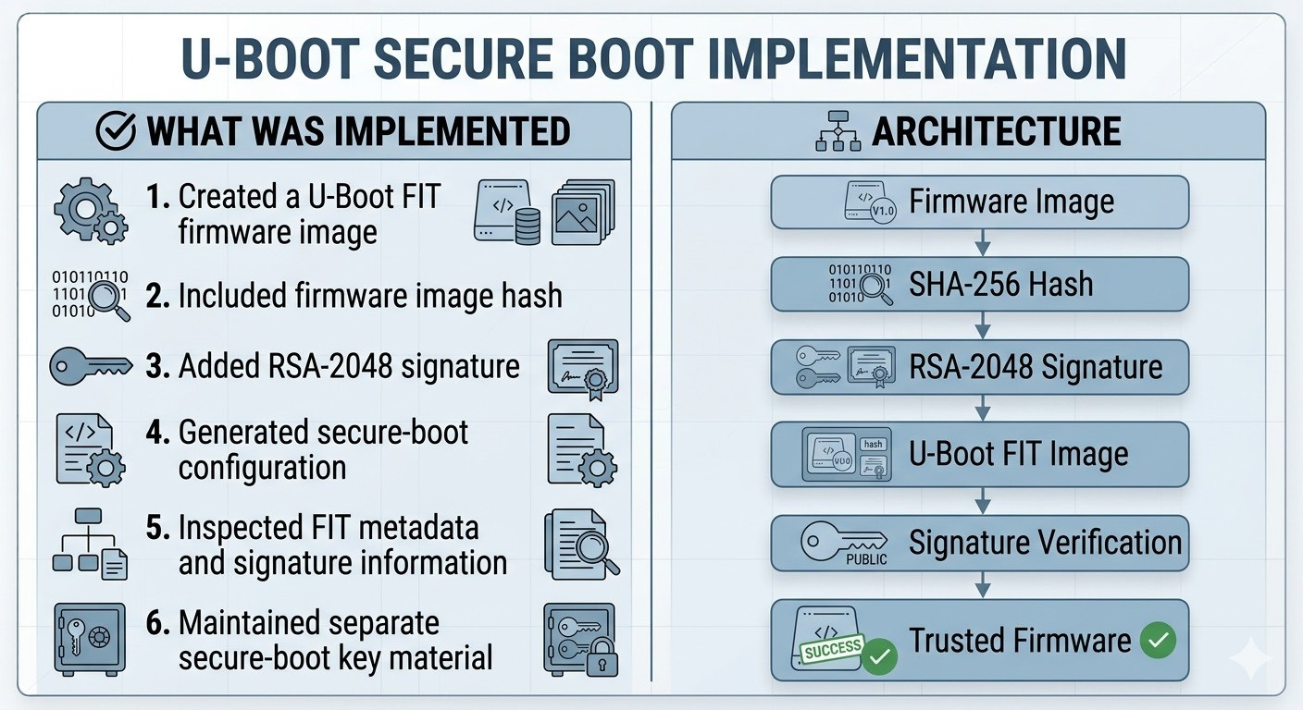

SECURE BOOT / U-BOOT FIT
IMPLEMENTED
FIT image creation and signature configuration
EVALUATED / LAB LIMITATION
Full U-Boot runtime secure-boot execution in QEMU was not completed as a stable end-to-end demonstration.

Slide 12

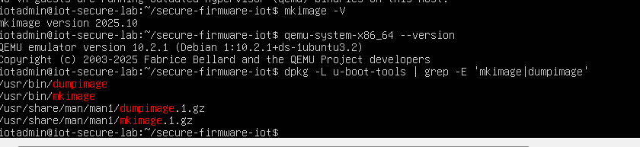
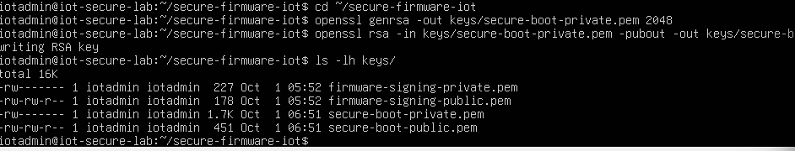
Evidence
U-Boot FIT secure-boot artifact implemented and evaluated in the laboratory.

Slide 13
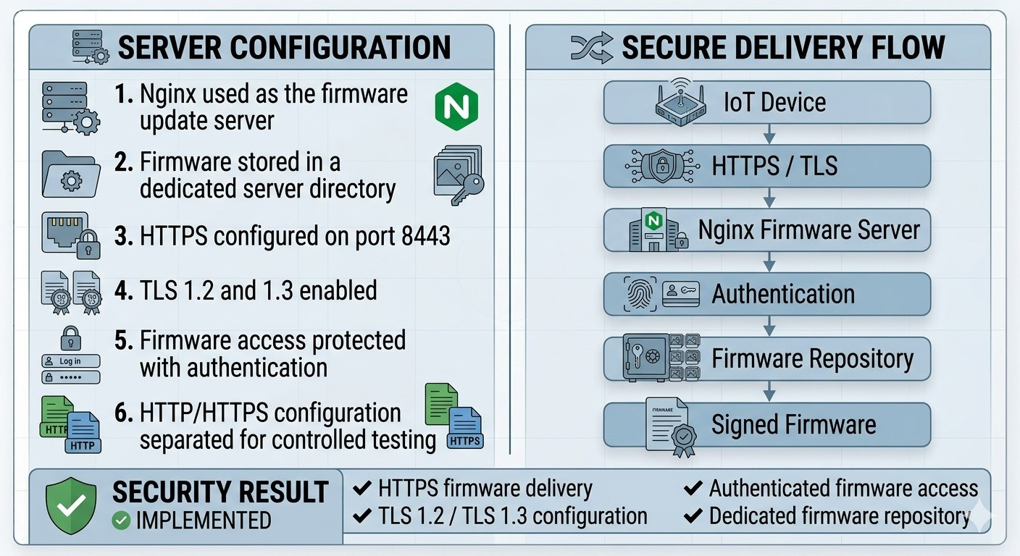
Secure Update Server & HTTPS/TLS

Slide 14

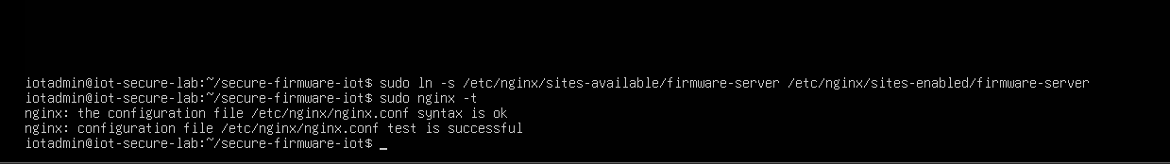
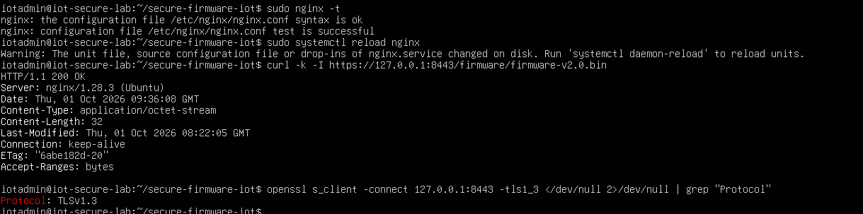
Evidence
Nginx Firmware Server
HTTPS / TLS Configuration

Slide 15
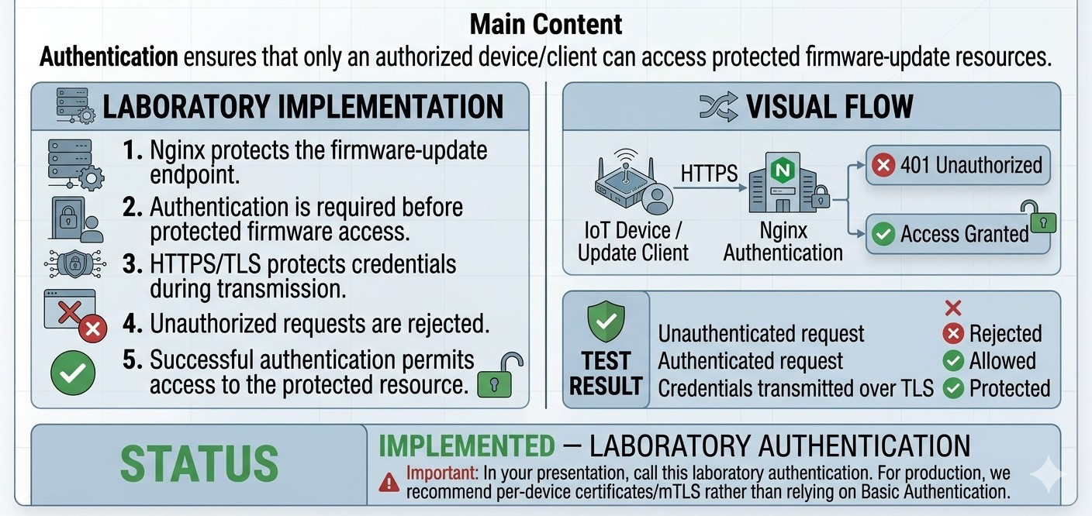
DEVICE AUTHENTICATION

Slide 16


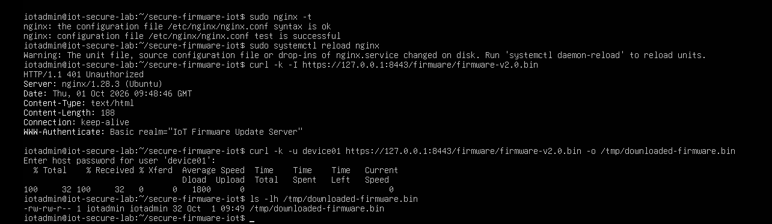
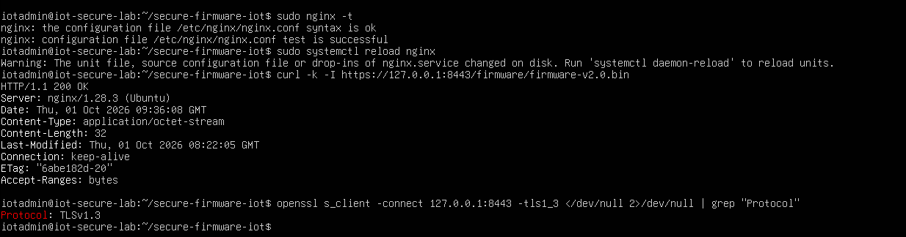
Evidence
Unauthorized access
Authenticated access

Slide 17
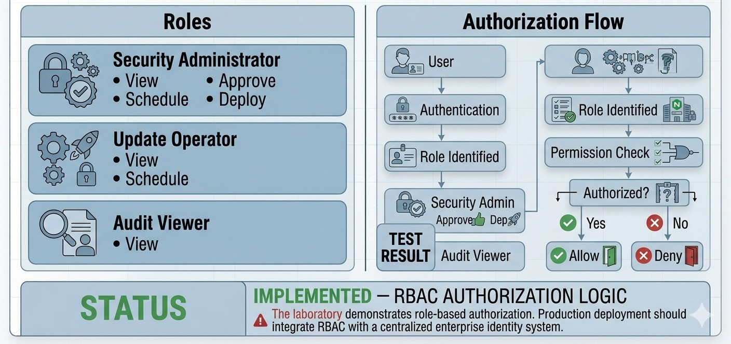
RBAC & Access Control

Slide 18


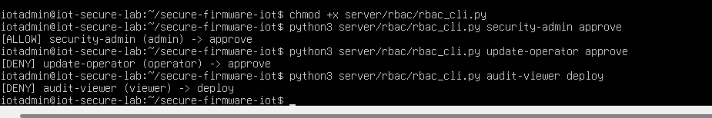
Evidence
Evidence-29-RBAC-Users-and-Roles
Evidence-30-RBAC-Authorization-Test

Slide 19
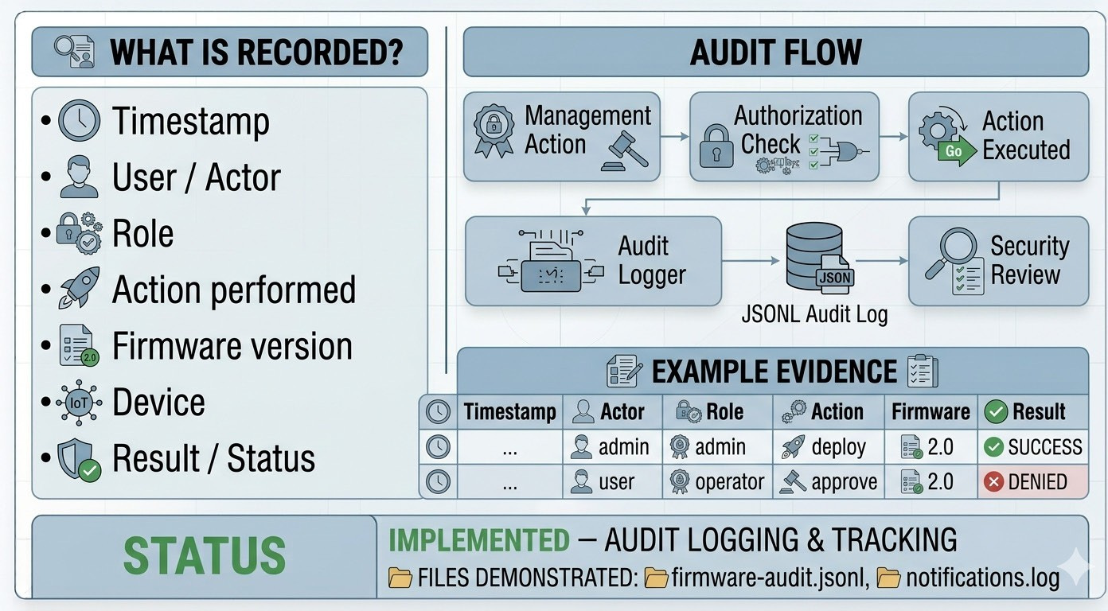
AUDIT LOGGING & MONITORING

Slide 20

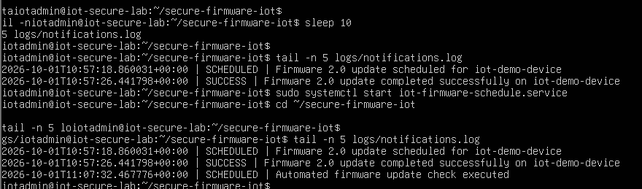
Evidence
notifications.log

Slide 21
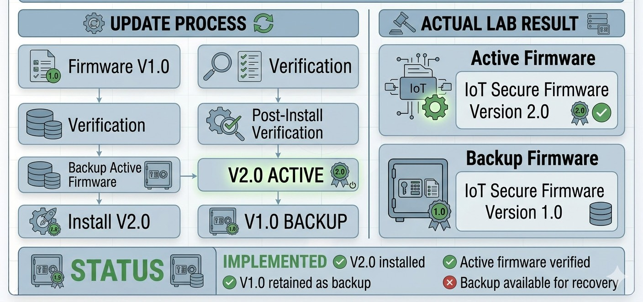
Firmware Installation & Backup

Slide 22

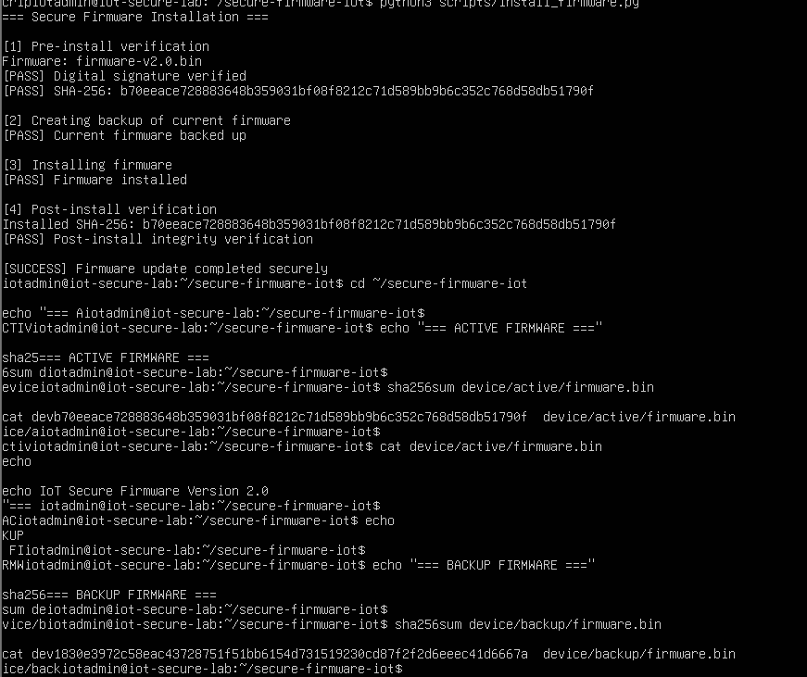
Evidence
=== ACTIVE FIRMWARE ===
IoT Secure Firmware Version 2.0
=== BACKUP FIRMWARE ===
IoT Secure Firmware Version 1.0

Slide 23
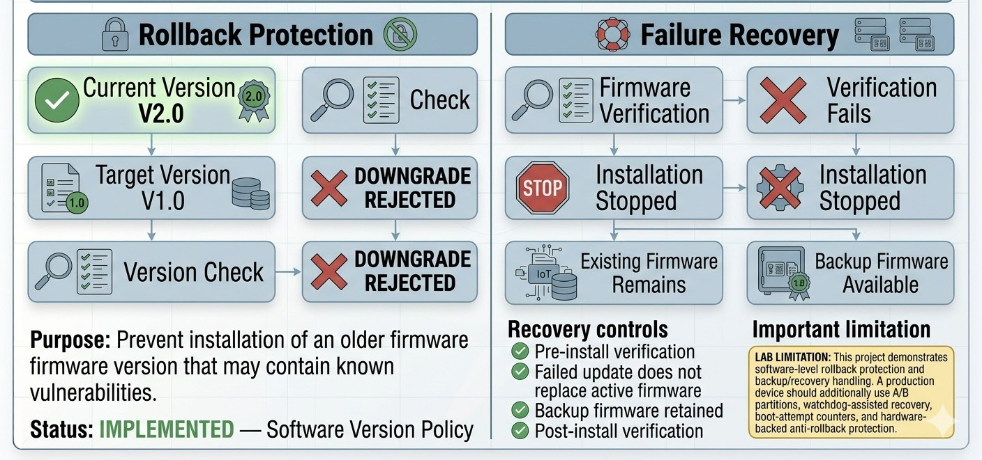
Rollback Protection & Failure Recovery

Slide 24

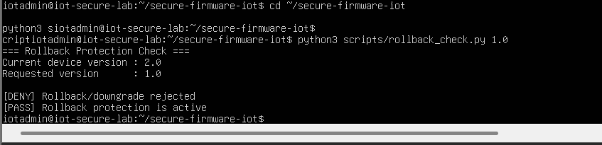
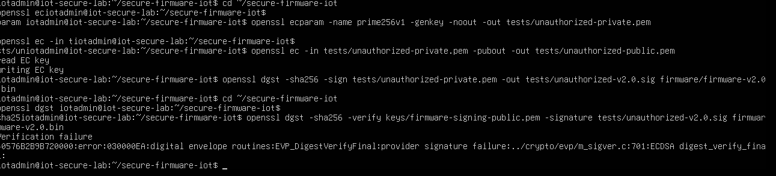
Evidence
V2.0 active / V1.0 backup
Your terminal showing the downgrade rejection.

Slide 25
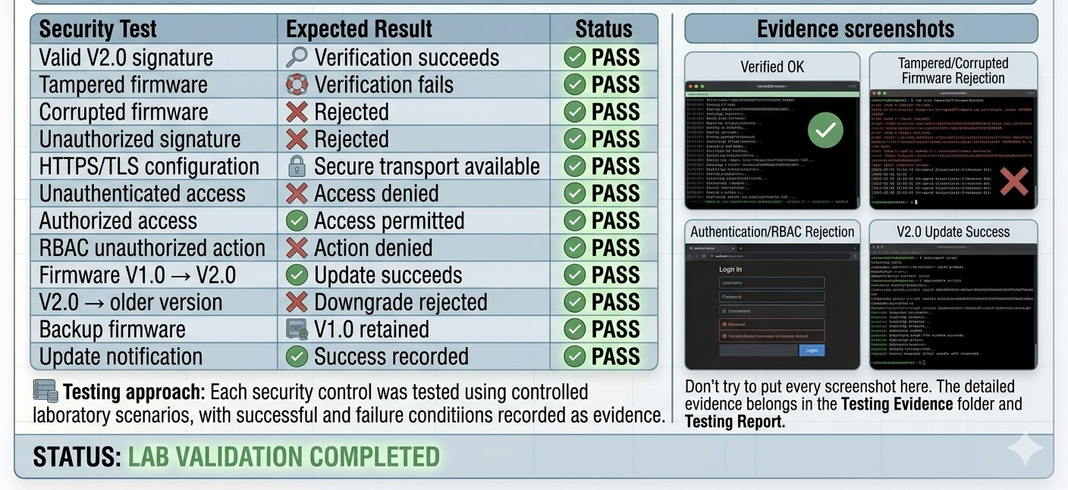
Testing & Validation

Slide 26
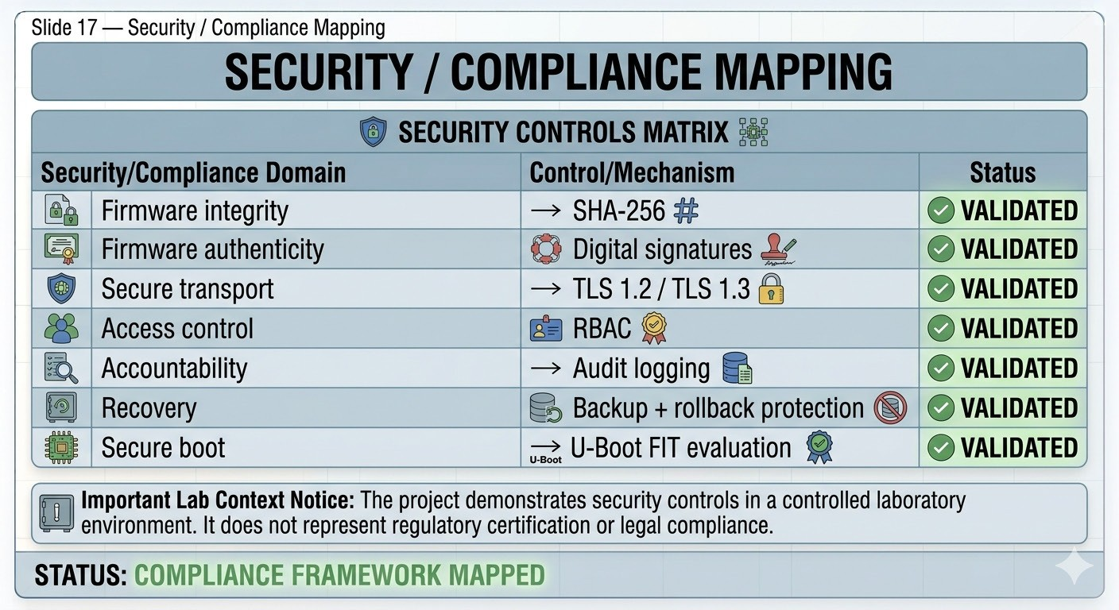
COMPLIANCE

Slide 27
KEY LIMITATIONS
Full hardware-backed Secure Boot was not demonstrated.
Hardware-backed anti-rollback was not implemented.
HSM/secure key vault was not used.
Production-grade device certificates/mTLS were not deployed.
Delta update optimization was evaluated rather than fully implemented.
A/B partition recovery was not deployed on physical IoT hardware.

Slide 28
CONCLUSION
The laboratory implementation demonstrates a trusted firmware-update lifecycle combining cryptographic verification, secure transport, authentication, RBAC, audit logging, rollback protection, backup, and recovery controls.
FINAL LINE
Secure Firmware s Secure Delivery s Verified Installation s Auditable Update Lifecycle
FINAL STATUS
PROJECT IMPLEMENTATION: COMPLETED — CONTROLLED LABORATORY DEMONSTRATION

